Slide 1
Query Processing
— Chapter 15
2021年11月
叶文
yewen@bupt.edu.cn
School of Computer Science (National Pilot Software Engineering School)

Slide 2
Introduction
Query
one or more operations on a database, or requests for DB access
a high-level database language (e.g. SQL, QUEL, declarative ) statement, or a sequence of statements
Query processing
(DBMS’ ) activities involved in extracting data from a database, including parsing and translation, query optimization, and evaluation (执行)
Programs compiling and executing vs. Query processing
refer to Fig. 12.0.1

Slide 3
C, C++, Java programs
query
程 序 编 译 / 编译器
词法/语法/语义分析
Query processing / DBMS
扫描和语法/语义分析
中间代码生成
关系代数表达式&查询树
Chapter15, 16
(中间)代码优化
查询优化
(§13)
(优化后)查询执行计划
目标代码生成
查询代码生成
(§12)
目标程序代码
查询计划执行的代码
process / thread
事务处理 / DBMS
transaction
程序执行 /
进程管理
&进程调度
并发控制
死锁处理
事务管理
&事务调度
并发控制
恢复技术
Chapter 17, 18, 19
死锁处理
OS
(§19)
(§17)
(§18)
Fig. 15.0.1

Slide 4
Outline
Overview
Measures of Query Cost
Selection Operation
Sorting
Join Operation
Other Operations
Evaluation of Expressions
Basic steps in query processing
Metrics for query measurement
Evaluating of individual relational algebra operations
Evaluating of expression, i.e. a sequence of relational algebra operations,

Slide 5
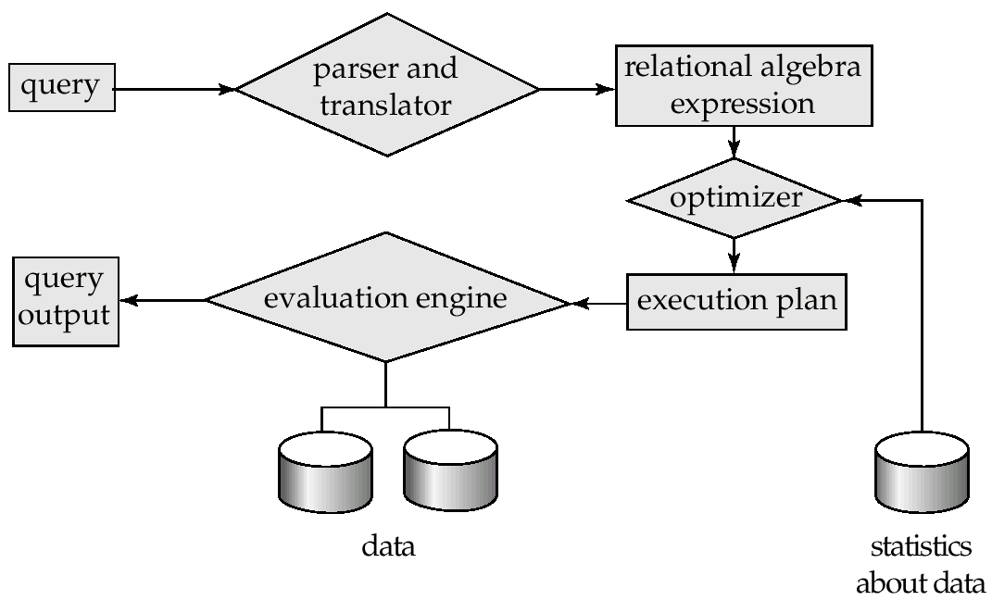
15.1 Overview
Steps in query processing
Fig.15.1
Users
Database System
e.g.
select
DBMS
1. Parsing and translation
2. Optimization
3. Evaluation
metadata in data dictionary
DB file
Fig.12.1 Steps in query processing

Slide 6
Overview
Step1.Parsing and translation
translate the query into a parser-tree representation
parser checks syntax, verifies the correctness of the relations in the query
parser also replaces the view in the query with the relations on which this view is built on
the parser-tree is then translated into relational algebra expression
Step2. Query Optimization
amongst all equivalent query evaluation plans, choose the one with lowest cost
the cost is estimated using statistical information in data dictionary
e.g. the number of tuples in each relation, size of tuples, etc

Slide 7
Optimization
A relational algebra expression may have many equivalent expressions
E.g., σ_{salary<75000}(∏_{salary}(instructor)) is equivalent to ∏_{salary}(σ_{salary<75000}(instructor))
Each relational algebra operation can be evaluated using one of several different algorithms
e.g. the select operation can be evaluated using one of A1, A2, …, A11 algorithms in §15.3
e.g. merge join, hash join operation
Correspondingly, a relational-algebra expression can be evaluated in many ways

Slide 8
Optimization
Annotated expression specifying detailed evaluation strategy is called an evaluation-plan, such as index, evaluation algorithms, etc.
e.g., can use an index on salary to find instructors with salary < 75000,
or can perform complete relation scan and discard instructors with salary ≥ 75000
∏_{salary}: A00
σ_{salary<2500} ; use index1
A5
instructor
Fig. 15.2 A query-evaluation plan

Slide 9
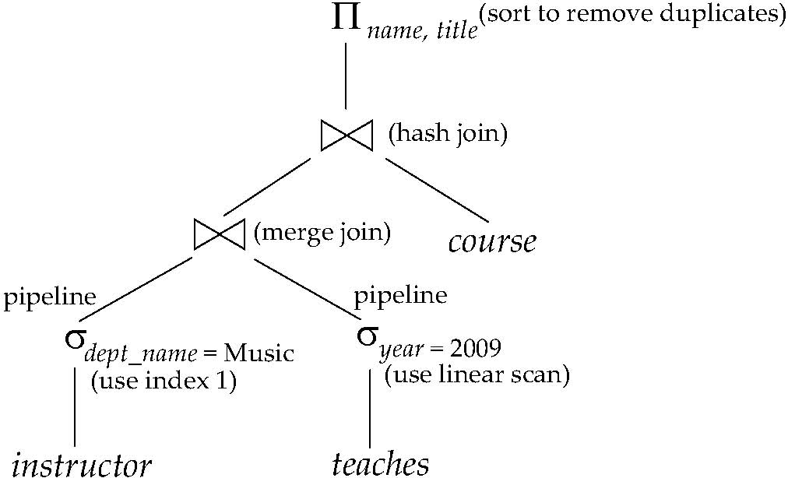
Overview
Step3. Evaluation plan execution
the query-execution engine takes a optimized query-evaluation plan, executes that plan, and returns the answers to the query

Slide 10
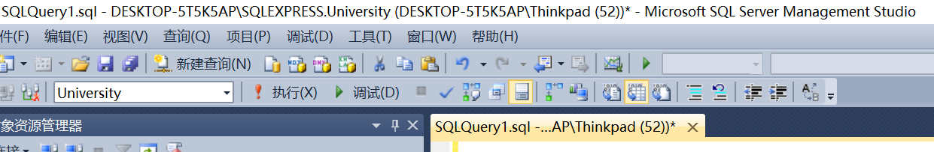
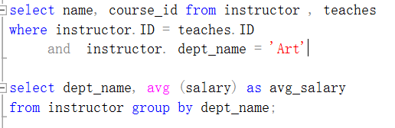
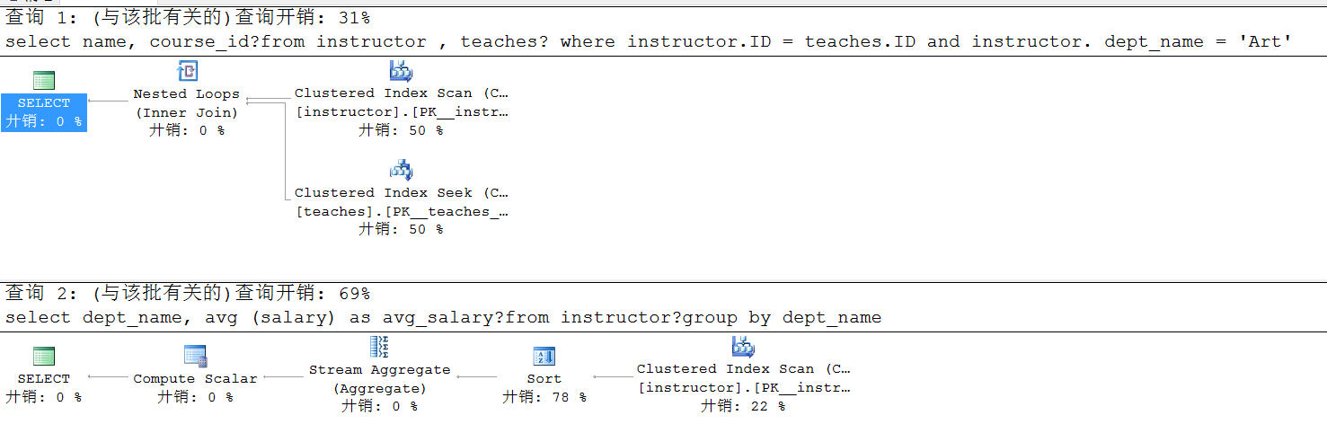

Slide 11
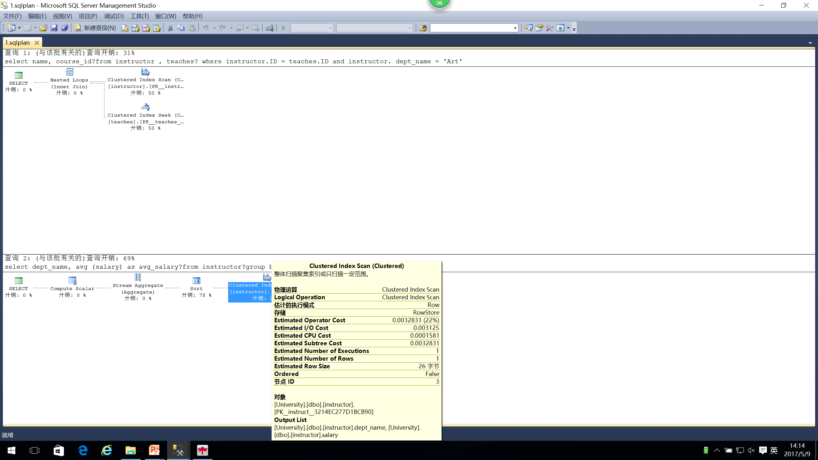

Slide 12
15.2 Measures of Query Costs
Cost is generally measured as total elapsed time for answering query，and many factors contribute to time cost
disk accesses
CPU
or even network communication
Typically disk access is the predominant cost, and is also relatively easy to estimate. Measured by taking into account
number of seeks * average-seek-cost
number of blocks read * average-block-read-cost
number of blocks written * average-block-write-cost
cost to write a block is greater than cost to read a block
data is read back after being written to ensure that the write was successful

Slide 13
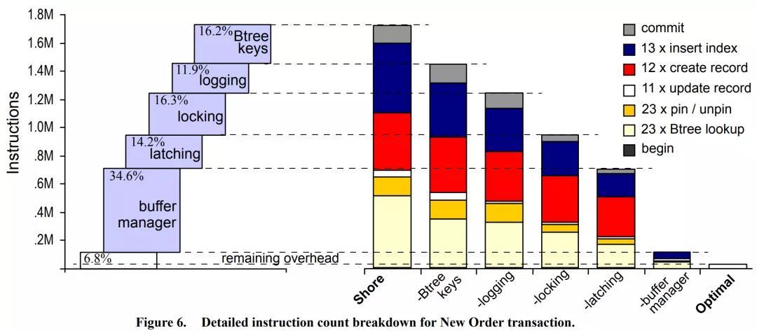
面向磁盘的数据库性能开销分析（2008年，SIGMOD论文）
假设一次业务处理（如SQL 查询）的总开销是100%，其中
7%不到，真正处理业务逻辑
34%，用于缓冲区管理如缓冲区的加载替换、地址转化等
14%，处理对于内存数据结构互斥访问加锁Latching
16%，处理事务并发访问时，事务处理加锁Locking
12%，处理日志Logging
16%，用于对B树索引的处理

Slide 14
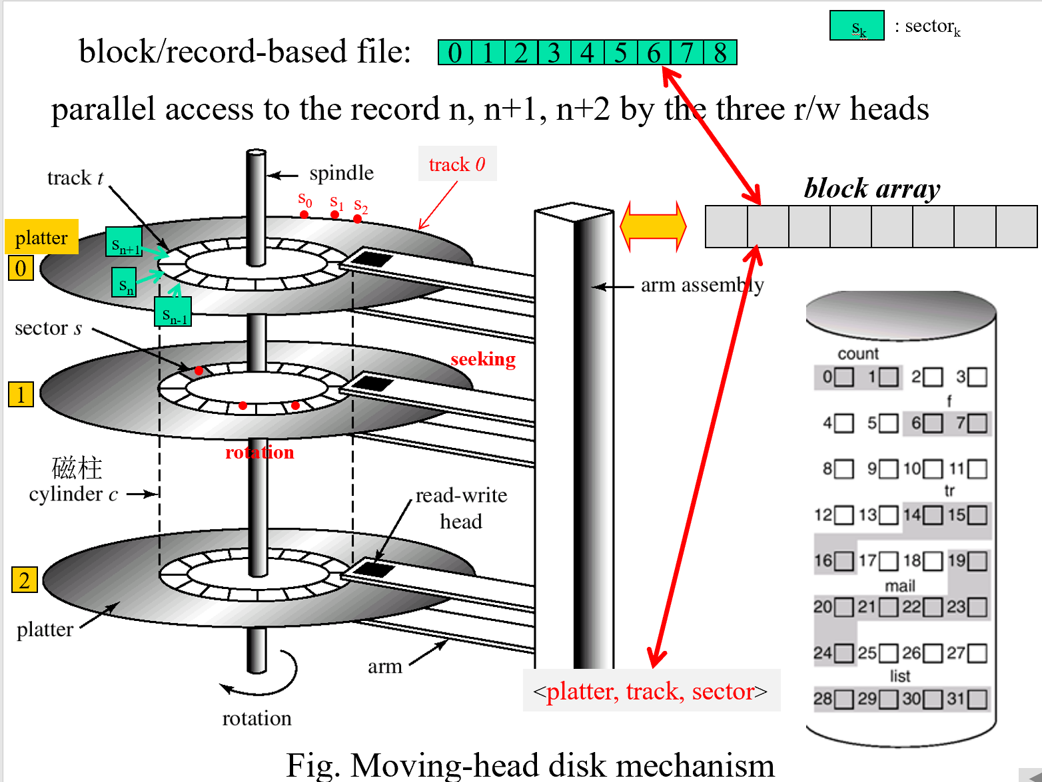
知乎：
为什么硬盘转速是3600、5400或7200这么奇怪的数字？
5400转/分钟
=5400 RPM，
美国交流电60Hz，
1分钟=60秒，
60Hz *1转/Hz * 60秒/分钟=3600转/分钟
5400 RPM=1.5*3600RPM
7200 RPM=2*3600RPM

Slide 15
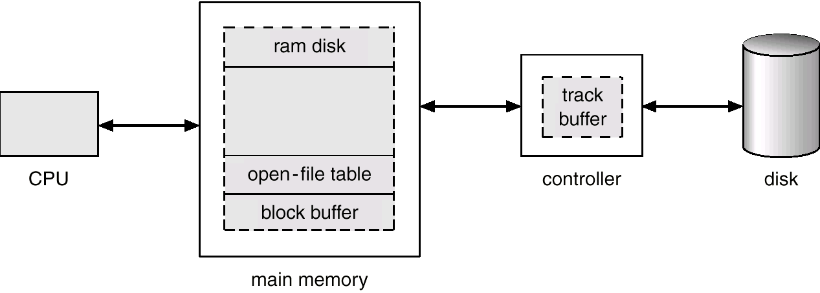
Magnetic Hard Disk Mechanism
Chunk/cluster-based
block-based
外部传输速率
内部传输速率
disk drive
track
on-board cache: set of blocks

Slide 16
Measures of Query Costs
For simplicity we just use the number of block transfered from disk and the number of seeks as the cost measures
t_{T} – time to transfer one block
t_{S} – time for one seek
time cost for b block transfers plus S seeks b * t_{T} + S * t_{S}
We ignore CPU costs for simplicity
real systems do take CPU cost into account
We do not include cost to writing output to disk in our cost formulae
cost = < b, S >

Slide 17
Measures of Query Costs
Several algorithms can reduce disk IO by using extra buffer space
Amount of real memory available to buffer depends on other concurrent queries and OS processes, known only during execution
We often use worst case estimates, assuming only the minimum amount of memory needed for the operation is available
Required data may be buffer resident already, avoiding disk I/O
But hard to take into account for cost estimation
内存数据库, e.g. Redis

Slide 18
12.3 Selection Operation
Selection operation on a relation r by file scan
locating and scanning the file in which r is stored to retrieving the file records satisfying the selection conditions
E.g. ∏_{salary}(σ_{salary<2500}(instructor))
select *
from instructor
where dept_name=‘Comp.Sci’

Slide 19
Selection Operation
Types of query conditions (查询条件类型)
equality(等值), e.g.salary = 100
range (范围), e.g. salary between 50 and 400
comparison (比较), e.g. salary >300
Several file scan algorithms
linear search/scan – A1
selections using indices – A2, A3, A4
selections involving comparisons – A5, A6
complex selections – A7, A8, A9, A10

Slide 20
A1: File scan by linear search
Algorithm A1 (linear search).
Scan each file block and test all records to see whether they satisfy the selection condition
cost estimate = b_{r} block transfers + 1 seek
= t_{S} + b_{r}*t_{T}
b_{r} : the number of blocks in file
//扫描全部blocks，方能找到全部满足查询条件的数据
if selection is on a key attribute, equality, can stop on finding record
average case: cost = (b_{r} /2) block transfers + 1 seek
= (b_{r} /2) * t_{T} + t_{S}
e.g. scan on account_number in account

Slide 21
A1: File scan by linear search
Linear search can be applied regardless of
selection condition or
ordering of records in the file, or
availability of indices
A1 algorithm is suitable for
seeking on a relational table organized as the heap file
scan on account_number or balance in account
seeking on a non-index attribute (non-search-key attribute) in a relational table organized as the sequential file, e.g. B/B+-tree file
index scan on balance in account
Note: binary search generally does not make sense since data is not stored consecutively
except when there is an index available,

Slide 22
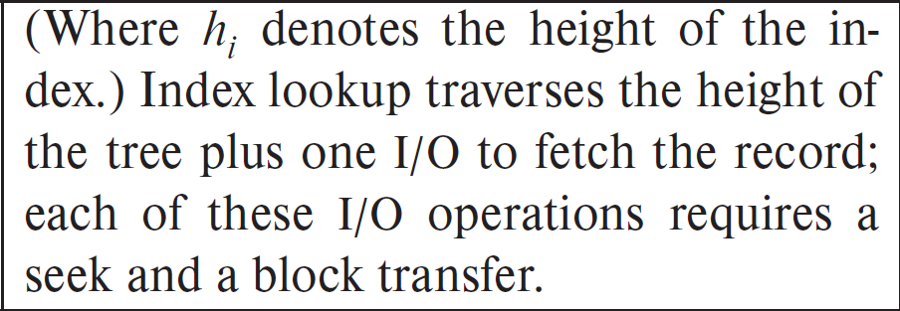
Selections Using Indices
Index scan/seek – search algorithms that use an index
e.g. in SQL Server, index seek/scan
selection condition must be on search-key of index, which may be key-attributes or non-key-attributes
i.e. instructor(ID, name, dept-name, salary)
A2 (clustering/primary index, B+-tree Index, equality on key )
Retrieve a single record that satisfies the corresponding equality condition, using a B⁺-tree as the clustering/primary index
e.g. seek on primary key ID in instructor
cost = (h_{i} + 1) * (t_{T} + t_{S})
h_{i} : height of the tree
t_{T} : time to transfer one block
t_{S} : time for one seek

Slide 23
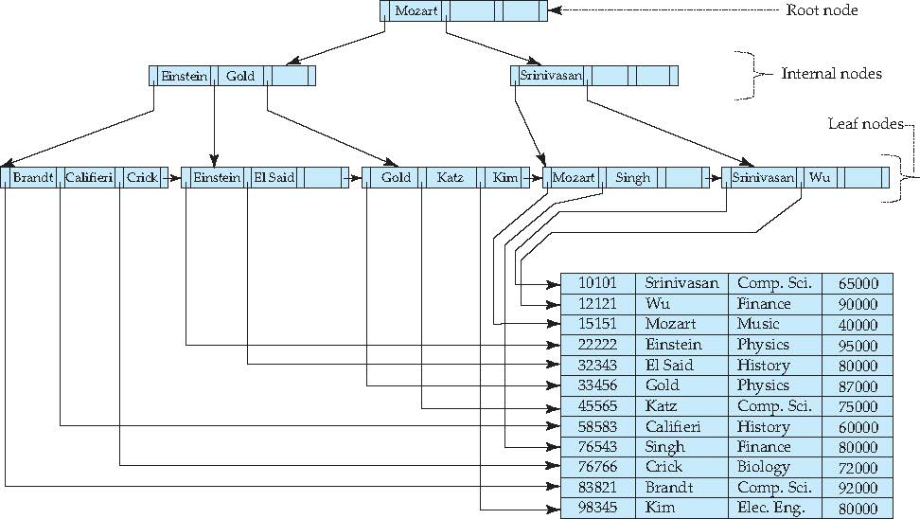
B⁺-Tree (n=4) Index Sequential File Primary/Clustering index on ID
文件记录直接存储在叶节点
B+树结果不唯一，取决于数据插入顺序
76543
2222
33456
83821
10101
12121
15151
22222
32343
33456
45565
58583
76543
76766
83821
98345
create table instructor
(ID integer, primary key;
name char(10);
department char(10);
salary integer;
)
Or: create clustered index IDIndex
on instructor(ID)

Slide 24
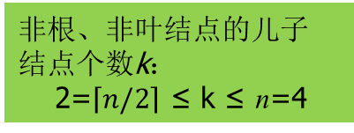
Secondary Index
select *
from instructor
where name <= ‘Gold’
Example of B⁺-Tree (n=4)
n: degree or branching factor
{Brandt, Califieri, Crick, Einstein, EI Said, Glod}
block#: 5,3, 4,1,2, 2
12 records
instructor(ID, name, dept_name, salary)
block0
block1
block2
block3
block4
block5

Slide 25
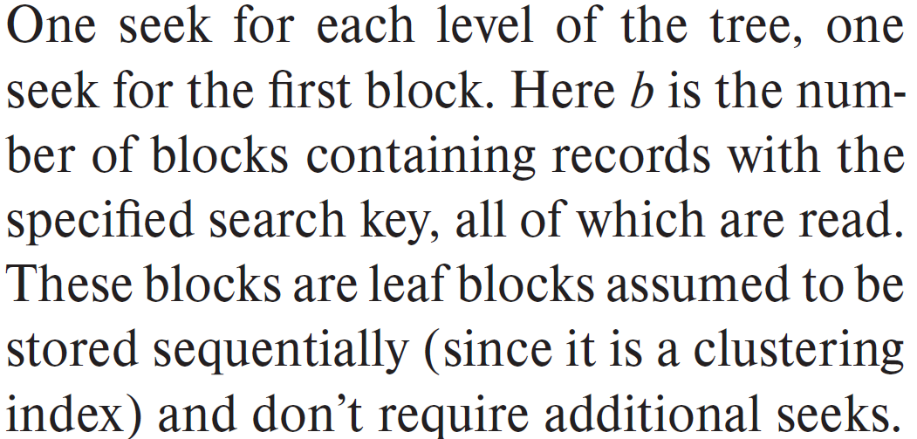
Selections Using Indices
A3 (primary/clustering index, B+-tree Index, equality on non-key)
Retrieve multiple records that satisfy select conditions
e.g. seek on non-key attribute branch_name in account
, and branch_name=‘Perryridge’
records will be on consecutive blocks
cost = h_{i} * (t_{T} + t_{S}) + t_{S} + t_{T} * b
b = number of blocks containing matching records
e.g. for branch_name=‘Perryridge’, b=3

Slide 26
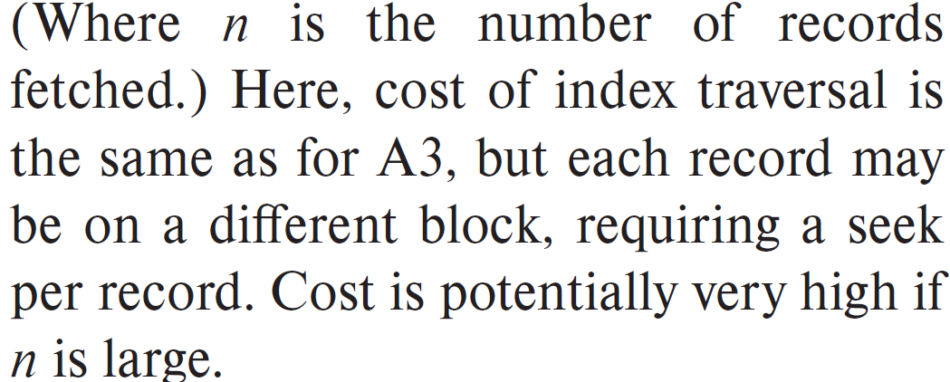
Selections Using Indices
A4 (secondary index, B+-tree Index, equality on key).
if the equality condition is on a key, only a single record is retrieved
e.g. seek on name in instructor
cost = (h_{i} + 1) * (t_{T} + t_{S})
, the same as that for a clustering index and A2 algorithm
if the equality condition is not on a key, multiple records (e.g. n records) may be retrieved
e.g. seek on salary=8000 in instructor , n=3
each of n matching records may be resident on a different block, which may result in on I/O operation per retrieved record, thus very expensive cost
cost = (h_{i} + n) * (t_{T} + t_{S})

Slide 27
buckets
instructor(ID, name, dept_name, salary)
99540 Wan Comp.Sci 87000
99800 Cui Finance 80000
Fig. 14.6 Secondary index on salary field of instructor

Slide 28
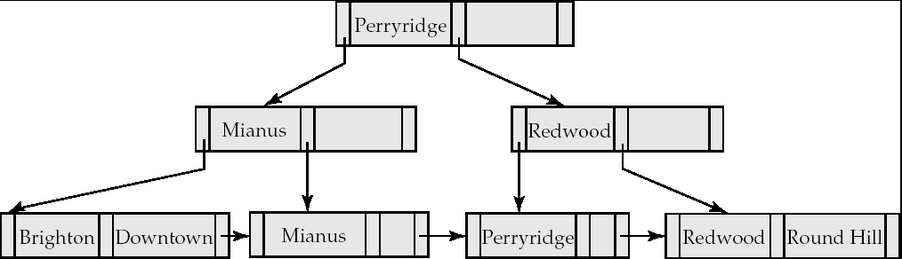
聚集索引树：索引+ 数据
访问方式：
1. 聚集索引查找seek on index-attribute，e.g. branch-name, n分查找seek
2. 聚集索引扫描scan on non-index-attribute, e.g. balance，线性扫描sacn
.
account(account-number, branch-name, balance)
seek
scan

Slide 29
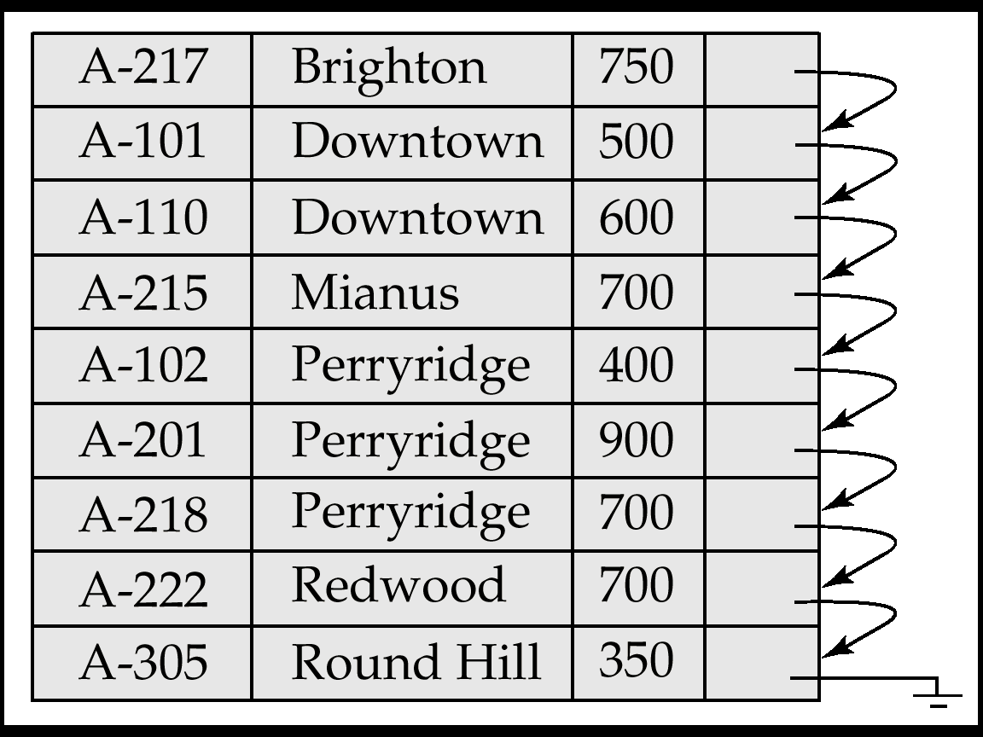
未建立索引，堆文件 访问方式：线性扫描、表扫描
Account(account_number, branch-name, balance)

Slide 30
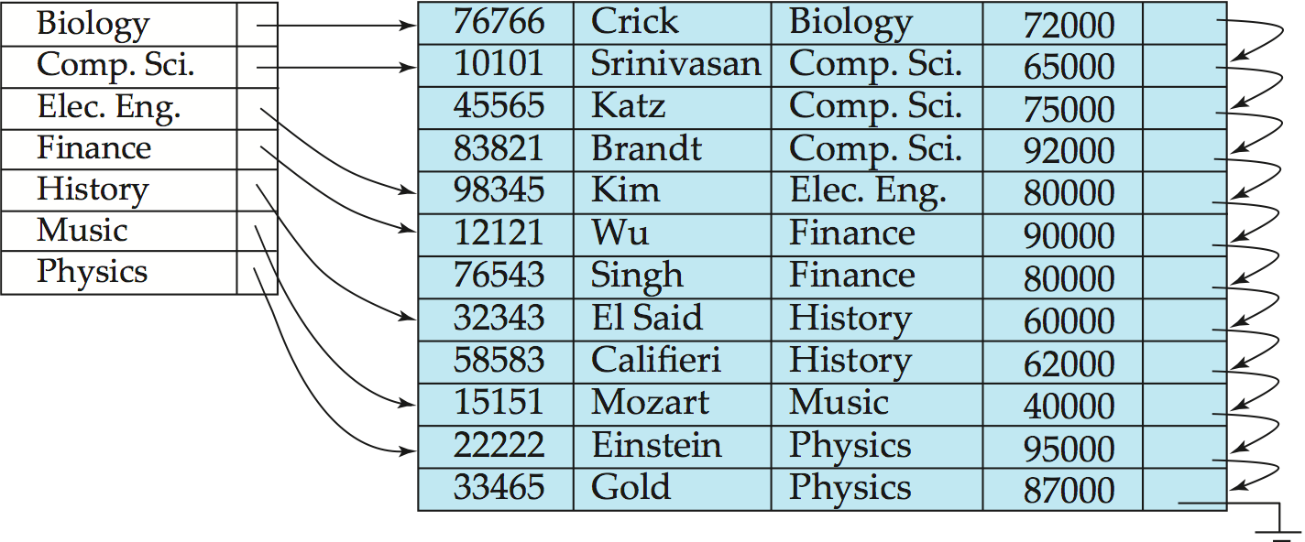
instructor(ID, name, dept_name, salary)
logical file
instructor
index file
Fig. 14.1 clustering index on non-key attribute dept_name in instructor:
indexed file instructor and its index file
indexed file
Note: the file instructor is logically a sequential file, but its records may be stored non-contiguously or non-ordered on the disk
76766
98345
58583
physical
file instructor
10101
12121
15151
45565
76543
22222
83821
32343
33465

Slide 31
Selections Involving Comparisons- Range Search
Can implement selections of the form σ_{A≤V} (r) or σ_{A ≥ V}(r) by using
a linear file scan,
or by using indices in the following ways:
A5 (clustering/primary index, B+-tree Index, comparison). (Relation is sorted on A)
For σ_{A ≥ V}(r) use index to find first tuple ≥ v and scan relation sequentially from there
For σ_{A≤V} (r) just scan relation sequentially till first tuple > v; do not use index
cost = h_{i} * (t_{T} + t_{S}) + t_{S} + t_{T} * b
b: number of blocks containing matching records
identical the case of A3
e.g. σ_{ID ≥ 45565} (instructor) in

Slide 32
Selections Involving Comparisons
A6 (secondary index, B+-tree Index, comparison).
e.g. σ_{name ≥ Gold} (instructor) in
For σ_{A ≥ V}(r) use index to find first index entry ≥ v and scan index sequentially from there, to find pointers to records
For σ_{A≤V} (r) just scan leaf pages of index finding pointers to records, till first entry > v
cost = (h_{i} + n) * (t_{T} + t_{S}),
In either case, retrieve records that are pointed to
requires an I/O for each record
linear file scan may be cheaper

Slide 33
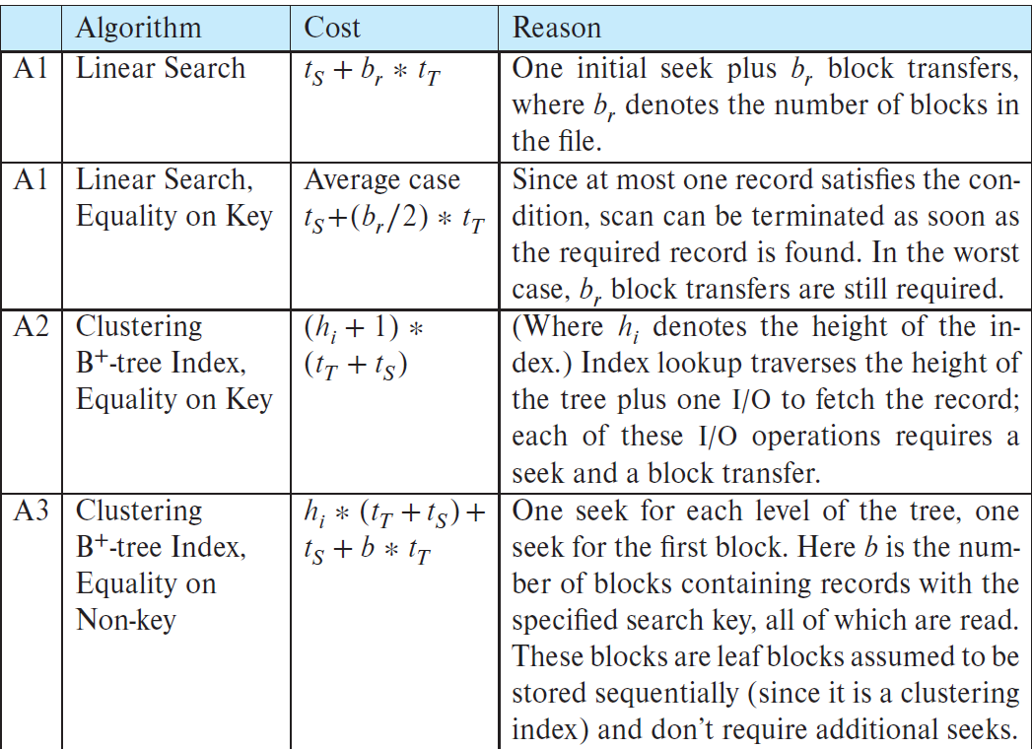
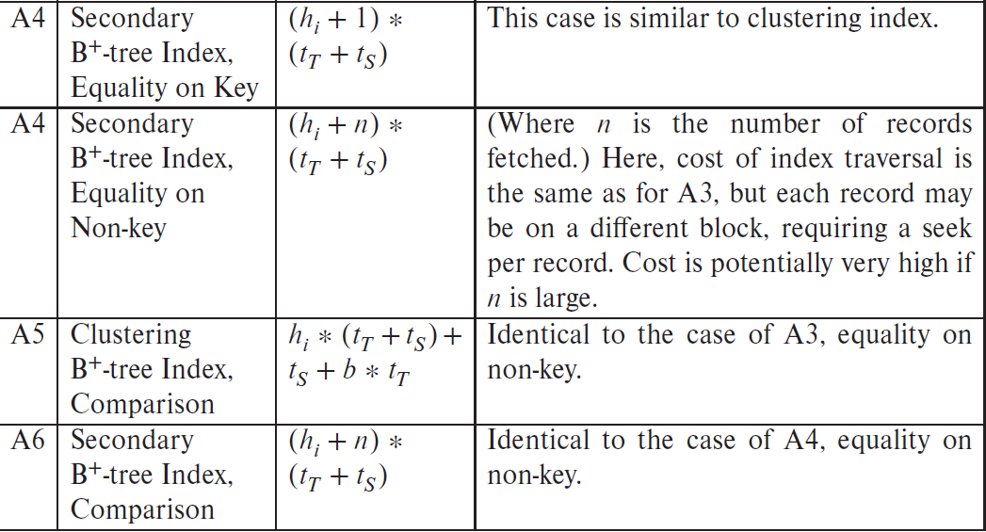

Slide 34
Bitmap Index Scan in PostgreSQL
The query optimizer in DBMS depends on the actual number of matching records in file to estimate query cost and choice appropriate query execution plans. However, if the number of matching records is not known accurately at compilation time, the choice may lead to bad performance
The bitmap index scan algorithm of PostgreSQL, when a secondary index is available
bridges gap between secondary index scan and linear file scan when number of matching records is not known before execution
bitmap with 1 bit per page in relation
Algorithm steps
step1. create a bitmap, with all bits initialized to 0
step2. use the secondary index to find the index entries for matching tuples, instead of fetching the tuples immediately, as each entry index is found, get the block number from the entry, and set the corresponding bit in the bitmap to 1
step3. once all entries have been processed, the bitmap is scanned to find all blocks whose bit is set to 1. these are exactly blocks containing matching records;
step4. then the file is scanned linearly from the head of the file, and the blocks with bit 1 are fetched, from which to retrieve the matching records

Slide 35
E.g. for the secondary index on instructor , given the query
select *
from instructor
where name <= ‘Gold’
seeking on the secondary index gives the bitmap and records the block addresses of the matching blocks, i.e.
bitmap:
block#: 0 1 2 3 4 5
matching records reside in block:
sequentially scanning the file from block0，and directed by the bitmap to fetch the records, with lower disk seeking time(disk access cost) and I/O cost
the matching records with names as
{Brandt, Califieri, Crick, Einstein, EI Said, Glod}
0 | 1 | 1 | 1 | 1 | 1
refer to disk scheduling in
Operating System Concepts
block#: 5, 3, 4, 1, 2, 2
block#: 0 1 2 3 4 5
compared with:
block#: 0 1 2 3 4 5
lower I/O cost
higher I/O cost

Slide 36
Implementation of Complex Selections- Conjunction
Conjunction: σ_{θ1}∧ _{θ2}∧. . . _{θn}(r)
A7 (conjunctive selection using one index)
select *
from instructor
where ID=1000 and dept_name=‘Comp.Sci’
select a combination of θ_{i} and algorithms A1 through A6 that results in the least cost for σ_{θi} (r)
test other conditions on tuple after fetching it into memory buffer
e.g.
1. seek the tuple with ID=1000 using index on ID
2. test whether or not the dept_name of this tuple is ‘Comp.Sci’
A8 (conjunctive selection using composite index).
Use appropriate composite (multiple-key) index if available

Slide 37

Implementation of Complex Selections- Conjunction
A9 (conjunctive selection by intersection of identifiers)
Requires indices with record pointers.
Use corresponding index for each condition, and take intersection of all the obtained sets of record pointers.
Then fetch records from file
If some conditions do not have appropriate indices, apply test in memory
//step1. 利用定义在每个查询条件θ_{i}的查询属性上的索引，查找满足θ_{i}的元组集合
step2. 取各个元组集合的交集
select *
from instructor
where ID=1000 and dept_name=‘Comp.Sci’
S1 $∩$ S2

Slide 38

Algorithms for Complex Selections
Disjunction:σ_{θ1}∨ _{θ2} ∨. . . _{θn} (r).
A10 (disjunctive selection by union of identifiers).
applicable if all conditions have available indices
otherwise use linear scan
use corresponding index for each condition, and take union of all the obtained sets of record pointers.
then fetch records from file
Negation: σ_{¬θ}(r)
Use linear scan on file
If very few records satisfy ¬θ, and an index is applicable to θ
Find satisfying records using index and fetch from file
select *
from instructor
where ID=1000 OR dept_name=‘Comp.Sci’
S1 $∪$ S2

Slide 39
15.4 Sorting
Sorting of data plays an important role in database system
select unique(attri_A)-from-where-order by
sorting on query result is needed
instructor join department
if the two relations are first sorted, join operation can be implemented efficiently
By sorting the database file , the records in relations are ordered physically, helping for efficiently processing
e.g. primary-key ID in table instructor results a primary index/B+-tree index
, in which the tuples are stored in ascending order of ID
For relations that fit in memory, techniques like quicksort can be used
Tuples/records in relations are stored in database files on disk, and for relations that are bigger than main memory in size, external sorting is needed to order database files on disk

Slide 40
Let M denote memory size (e.g. 3, in pages)
1. Create sorted runs. Let i be 0 initially. Repeatedly do the following till the end of the relation: (a) Read M blocks of relation into memory (b) Sort the in-memory blocks (c) Write sorted data to run R_{i}; increment i.
Let the final value of i be N
2. Merge the runs
…

Slide 41
非递归合并排序
—算法设计与分析
输出序列
1 | 2 | 3 | 4 | 6 | 7 | 8 | 9
merge → MergePass → MergeSort
合并
2 | 4 | 7 | 9
1 | 3 | 6 | 8
2 | 7
4 | 9
3 | 8
1 | 6
7
2
9
4
3
8
6
1
输入序列a[]

Slide 42
15.5 Join 【略】
Several different algorithms to implement joins
Nested-loop join
Block nested-loop join
Indexed nested-loop join
Merge-join
Hash-join
Choice based on cost estimate
Examples use the following information
Number of records (denoted as n) of student: 5,000 takes: 10,000
Number of blocks (denoted as b) of student: 100 takes: 400

Slide 43
Nested-Loop Join
r
s
To compute the theta join r ⨝ _{θ} s for each tuple t_{r} in r do begin for each tuple t_{s} in s do begin test pair (t_{r},t_{s}) to see if they satisfy the join condition θ if they do, add t_{r} • t_{s} to the result. end end
r is called the outer relation and s the inner relation of the join.
Requires no indices and can be used with any kind of join condition.
Expensive since it examines every pair of tuples in the two relations.
t_{r}.A
t_{s}.A
t_{r}
t_{s}
|r|=m
连接属性A
|s|=n

Slide 44
Nested-Loop Join
In the worst case, if there is enough memory only to hold one block of each relation, the estimated cost is n_{r} ∗ b_{s} + b_{r} block transfers, plus n_{r} + b_{r} seeks
If the smaller relation fits entirely in memory, use that as the inner relation.
Reduces cost to b_{r} + b_{s} block transfers and 2 seeks
Assuming worst case memory availability cost estimate is
with student as outer relation:
5000 ∗ 400 + 100 = 2,000,100 block transfers,
5000 + 100 = 5100 seeks
with takes as the outer relation
10000 ∗ 100 + 400 = 1,000,400 block transfers and 10,400 seeks
If smaller relation (student) fits entirely in memory, the cost estimate will be 500 block transfers.
Block nested-loops algorithm (next slide) is preferable.

Slide 45
Indexed Nested-Loop Join
Index lookups can replace file scans if
join is an equi-join or natural join and
an index is available on the inner relation’s join attribute
Can construct an index just to compute a join.
For each tuple t_{r} in the outer relation r, use the index to look up tuples in s that satisfy the join condition with tuple t_{r}.
Worst case: buffer has space for only one page of r, and, for each tuple in r, we perform an index lookup on s.
Cost of the join: b_{r} (t_{T} + t_{S}) + n_{r} ∗ c
Where c is the cost of traversing index and fetching all matching s tuples for one tuple or r
c can be estimated as cost of a single selection on s using the join condition.
If indices are available on join attributes of both r and s, use the relation with fewer tuples as the outer relation.

Slide 46
Example
Compute student ⨝ takes, with student as the outer relation.
Let takes have a primary B⁺-tree index on the attribute ID, which contains 20 entries in each index node.
Since takes has 10,000 tuples, the height of the tree is 4, and one more access is needed to find the actual data
student has 5000 tuples
Cost of block nested loops join
400*100 + 100 = 40,100 block transfers + 2 * 100 = 200 seeks
assuming worst case memory
may be significantly less with more memory
Cost of indexed nested loops join
100 + 5000 * 5 = 25,100 block transfers and seeks.
CPU cost likely to be less than that for block nested loops join

Slide 47
Merge-Join
Step1. sort both relations on their join attribute, if not already sorted on the join attributes
Step2. Merge the sorted relations to join them
1. Join step is similar to the merge stage of the sort-merge algorithm.
2. Main difference is handling of duplicate values in join attribute —
every pair with same value on join attribute must be matched
3. Detailed algorithm in book

Slide 48
Merge-Join
Can be used only for equi-joins and natural joins
Each block needs to be read only once (assuming all tuples for any given value of the join attributes fit in memory
Thus the cost of merge join is: b_{r} + b_{s} block transfers + ⎡b_{r} / b_{b}⎤ + ⎡b_{s} / b_{b}⎤ seeks
+ the cost of sorting if relations are unsorted.
hybrid merge-join: If one relation is sorted, and the other has a secondary B⁺-tree index on the join attribute
Merge the sorted relation with the leaf entries of the B⁺-tree .
Sort the result on the addresses of the unsorted relation’s tuples
Scan the unsorted relation in physical address order and merge with previous result, to replace addresses by the actual tuples
Sequential scan more efficient than random lookup

Slide 49
Hash-Join
Applicable for equi-joins and natural joins.
A hash function h is used to partition tuples of both relations
h maps JoinAttrs values to {0, 1, ..., n}, where JoinAttrs denotes the common attributes of r and s used in the natural join.
r₀, r₁, . . ., r_{n} denote partitions of r tuples
Each tuple t_{r} ∈ r is put in partition r_{i} where i = h(t_{r} [JoinAttrs]).
r₀,, r₁. . ., r_{n} denotes partitions of s tuples
Each tuple t_{s} ∈s is put in partition s_{i}, where i = h(t_{s} [JoinAttrs]).
Note: In book, Figure 12.10 r_{i} is denoted as H_{ri,} s_{i} is denoted as H_{si} and n is denoted as n_{h.}

Slide 50
Hash-Join

Slide 51
Hash-Join
r tuples in r_{i} need only to be compared with s tuples in s_{i} Need not be compared with s tuples in any other partition, since:
an r tuple and an s tuple that satisfy the join condition will have the same value for the join attributes.
If that value is hashed to some value i, the r tuple has to be in r_{i} and the s tuple in s_{i}.

Slide 52
15.7 Evaluation of Expressions
How to evaluate an expression containing multiple evaluation primitives
key: how to process intermediate computing results
e.g. ∏_{sarlay}(σ_{salary<2500}(instructor))
Two strategies, that is materialization(实体化/物化) and pipeline are used for expression evaluation
Materialization: generate results of an expression whose inputs are relations or are already computed, materialize (store) it on disk. Repeat.
Pipelining: pass on tuples to parent operations even as an operation is being executed

Slide 53
Materialization
Principles
start from the lowest-level, i.e. at the bottom of the tree, evaluate one operation at a time
the results of each evaluation (i.e. intermediate computing results) are stored in temporal relations on the disk for subsequent evaluation
serial evaluating
E.g., in Fig.15.0.2, compute and store in a temporal relation at first
Cost of writing results to disk and reading them back can be quite high
Approximately,
overall cost =
sum of costs of individual operations + cost of writing intermediate results to disk
salary
instructor

Slide 54
Materialization
Temp数据库
Fig. 15.0.2 Pictorial representation of an expression

Slide 55
Pipelined
Principles of pipelined evaluation
evaluate several operations simultaneously in a pipeline, with the results of one operation passed to the next, without the need to store temporary relations in disk
parallel evaluating
Much cheaper than materialization:
no need to store a temporary relation to disk
E.g., in the expression tree in Fig.15.0.2, don’t store result of
instead, pass tuples directly to the join; similarly, don’t store result of join, pass tuples directly to projection.
salary
instructor

Slide 56
instructor
σ_{salary<2500}
……
∏_{salary}
:
……
∏_{salary}(σ_{salary<2500})
salary<2500
salary≥2500

Slide 59

Thanks for your attention

